Slide 1

Engineering Education in
Hong Kong Secondary Schools -
The Applied Learning Course Approach
Ken Hui
Engineering Discipline, Hong Kong Institute of Vocational Education
Vocational Training Council
14. 9. 2023

Slide 2

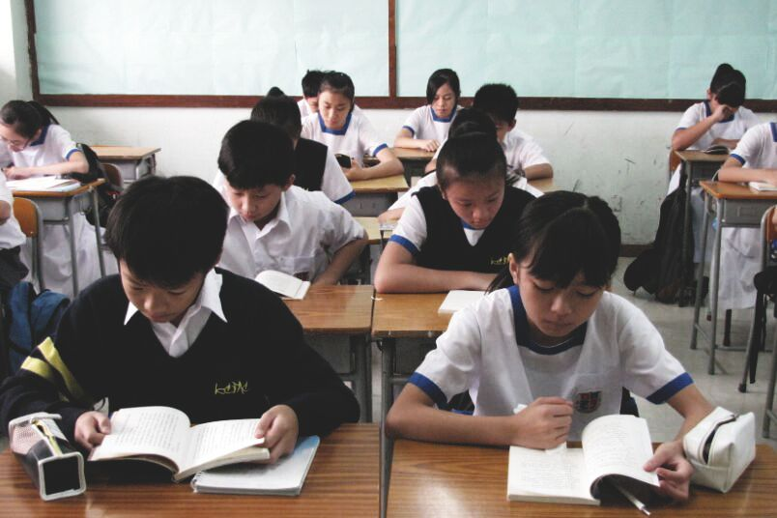
Background
In Hong Kong, engineering education is not explicitly included in mainstream secondary schools curriculum
Engineering knowledge is infused into science, technology and mathematics (STM) subjects
Usually, the knowledge is delivered through extra-curricular activities, inter-school competitions, or career talks

Slide 3

Aim and Objectives
Aim of Study
This paper aims to propose an effective mechanism of engineering education in secondary schools by conducting a practical case study of Applied Learning courses (ApL) in current secondary school curriculum in Hong Kong.

Slide 4

Aim and Objectives (Cont’d)
Objectives of Study
To briefly review the existing problems of engineering education in Hong Kong secondary schools
To study the effectiveness of the implementation of ApL in secondary school curriculum
To provide recommendations on improving the design and structure of ApL courses

Slide 5

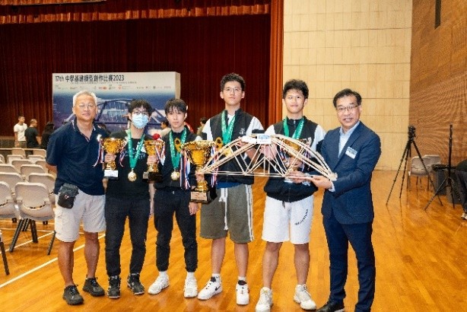
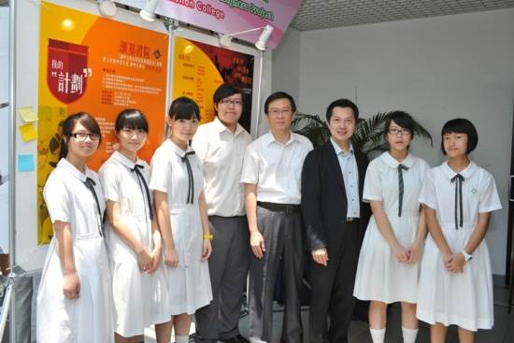
Existing Problems of Engineering Education in Hong Kong Secondary Schools
Limited engineering-oriented subjects in secondary school curriculum
Few secondary school teachers are with engineering qualifications and background
These may deter the students' aspirations to pursue further studies in engineering and to become engineers eventually

Slide 6
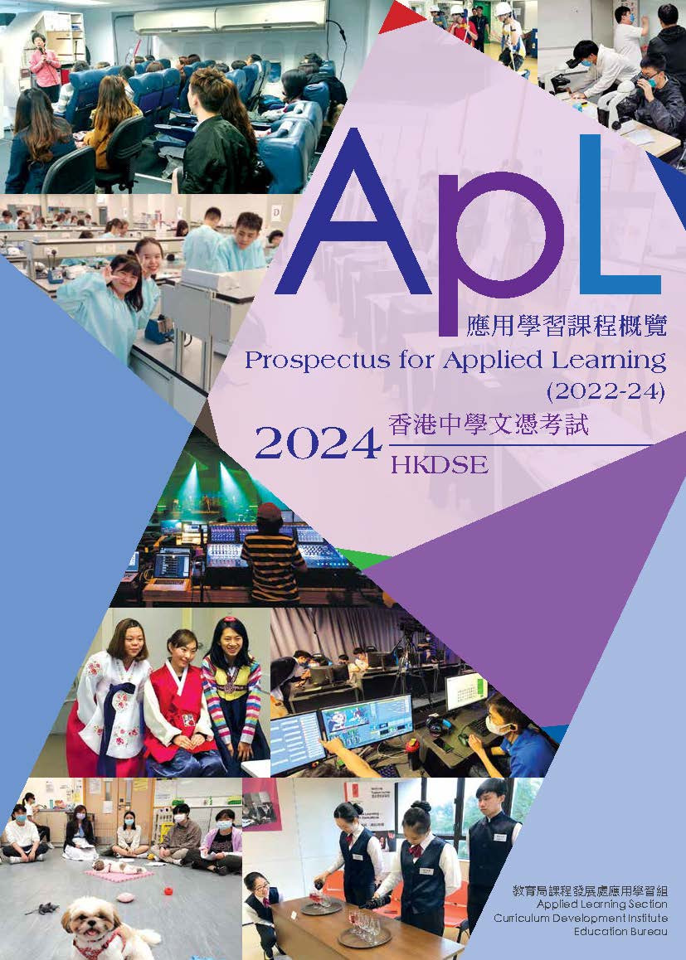
Applied Learning Course (ApL)
Applied Learning Courses (ApL) are introduced to diversify the curriculum of senior secondary students by the Education Bureau of the Hong Kong SAR government
ApL Courses emphasize the development of fundamental skill set, career-related competencies and generic skills of students, and explore their career aspirations and orientation for lifelong learning

Slide 7
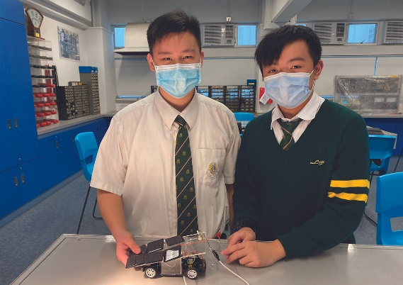
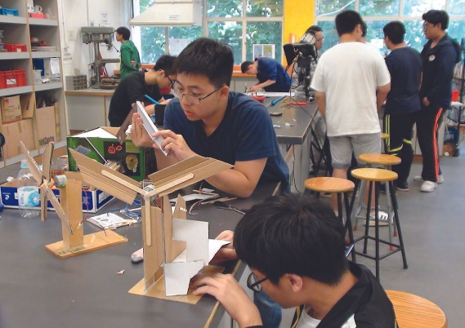
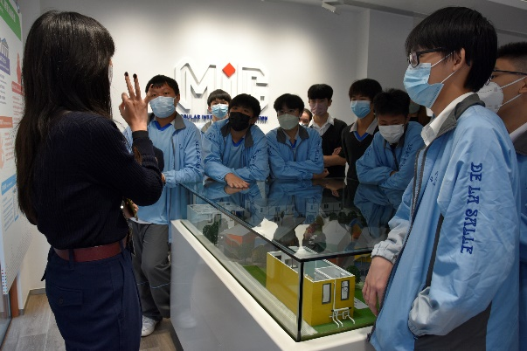
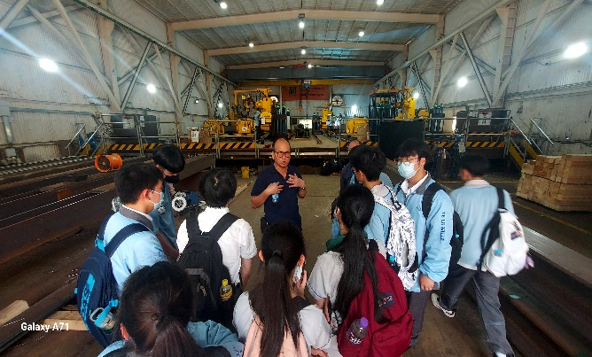
Case Studies
1. Electrical and Energy Engineering
2. Digital Construction

Slide 8
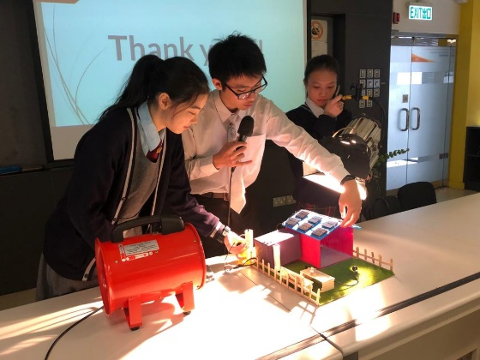
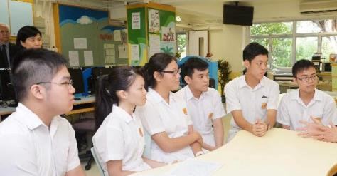
Curriculum Design
Student Projects
To integrate and apply learned knowledge in completing an end-of-course student project
To develop basic research and presentation skills
Overall guiding principles
Career-related Competencies
Foundation Skills
Thinking Skills
People Skills
Value and Attitudes
Modules
Overview of the Industries
Theory and Practice
Problem-solving, Critical Thinking and Communication Skills

Slide 9
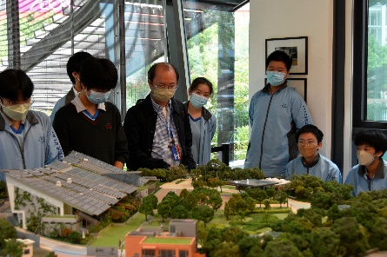
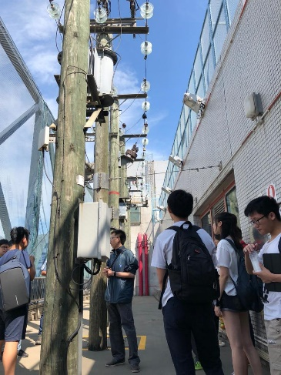
Pedagogy
 | Type of teaching and learning activity | Purpose
1 | Classroom teaching | Knowledge sharing and delivery
2 | Group discussion and presentation | Reflection of knowledge acquired and sharing of ideas
3 | Experiment and workshop | Practical training and application of solutions to practical tasks
4 | Project | Knowledge integration and implementation
5 | Company and facilities visit | Appreciation of real life practice and know-how
Problem-based Learning
Active Student Engagement

Slide 10
Assessments
Study Report
Presentation
Project
Test
Assessment of information gathering, analysis and writing abilities
Assessment of communication skills and question-handling abilities
Assessment of overall integration of theory and practice, and problem-solving skills
Examination of knowledge gained

Slide 11
Results and Discussion
2. Applications of Engineering Concepts
4. Teamwork and Communication related to Engineering
1. Design Process
Evaluating Criteria
5. Exposure to Engineering Environment
3. Problem Solving

Slide 12
Results and Discussion (Cont’d)
Criteria | Result
Design Process | Different kinds of engineering tasks which involve design process are included in the courses, such as design of electrical energy system and BIM models
Applications of Engineering Concepts | Engineering concepts such as fundamental engineering knowledge, actual engineering practice, new technology and advancement of the engineering professions are widely introduced in different modules

Slide 13
Results and Discussion (Cont’d)
Criteria | Result
Problem Solving | The courses are highly practical in which students are asked to tackle problems based on knowledge, information and data and statutory requirements
Teamwork and Communication related to Engineering | Teamwork and communication are particularly applied in the integrated project modules
Exposure to Engineering Environment | The design of teaching and learning activities offers strong interaction with the engineering industry

Slide 14
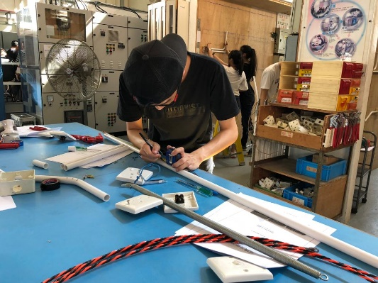
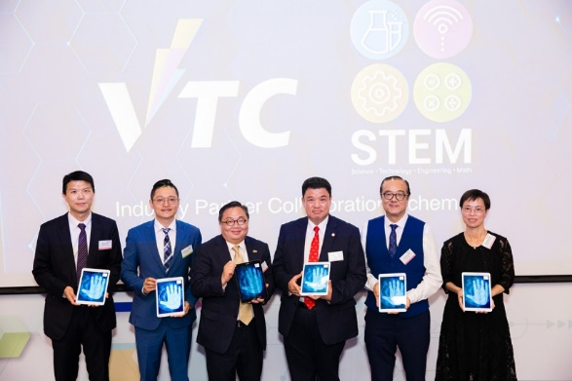
Recommendations
1. Interaction between ApL courses and STM subjects
Students are encouraged and facilitated to apply knowledge learned from STM subjects to engineering tasks, which help them relate the knowledge to the engineering world

Slide 15

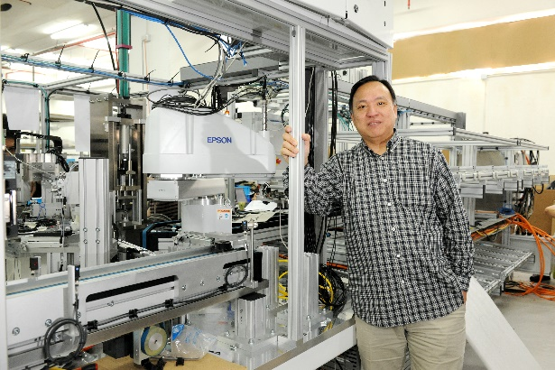
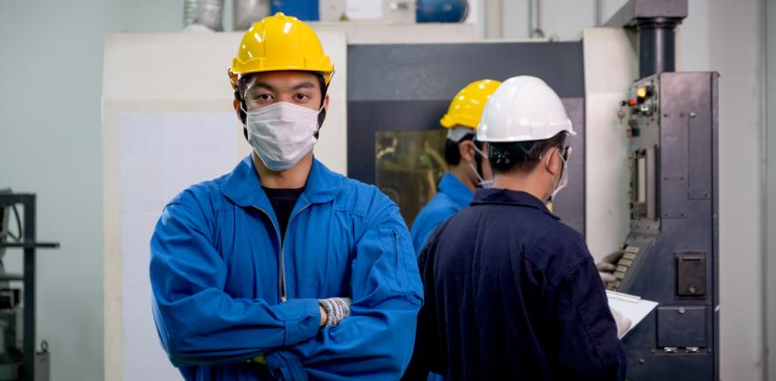
Recommendations (Cont’d)
2. Support from Engineering Industry
Supports range from professional advice to the course curriculum, guest lectures, company and facilities visits, scholarship and internship opportunities can strongly improve the quality and attractiveness of the ApL courses

Slide 16

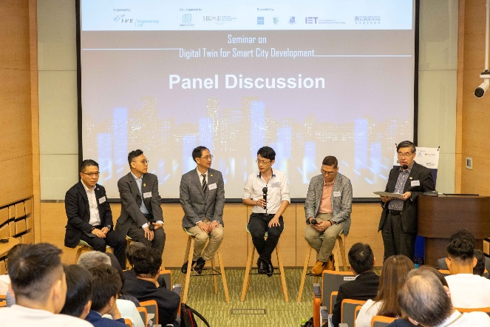
Recommendations (Cont’d)
3. Introduction of Advanced Technology in Engineering
Advanced technology in engineering such as artificial intelligence, robotics, internet of things and design software should be largely adopted to arouse the interest of students in engineering

Slide 17
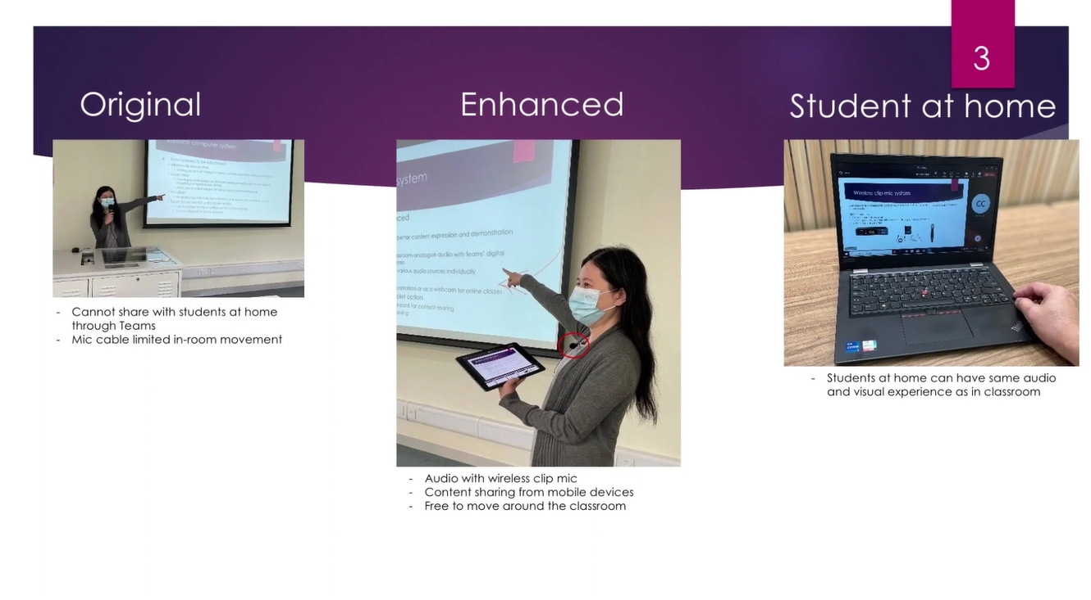
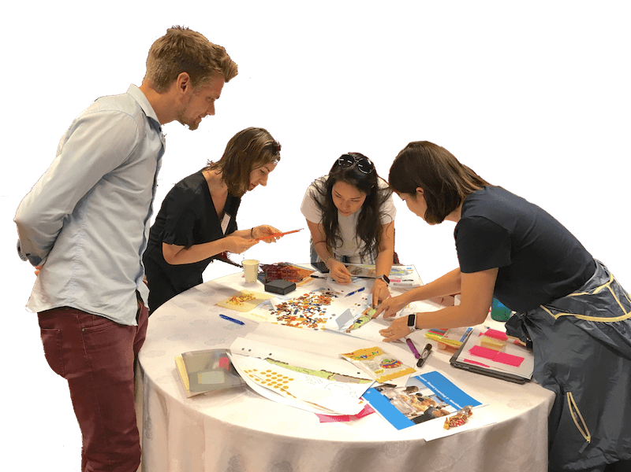
Recommendations (Cont’d)
4. Enhancements of Pedagogies
Pedagogies such as technology enhanced learning, project based learning and active student engagement can be strengthened and adopted to the courses

Slide 18
References (selected)
Felder, R.M. (2012). Engineering education: A tale of two paradigms. Shaking the foundations of Geo-Engineering education, 9-14.
Kutnick, P., Chan, R. Y-Y., Chan, C. K. Y., Good, D., Lee, B. P-Y., & Lai, V. K. W. (2018). Aspiring to become an engineer in Hong Kong: effects of engineering education and demographic background on secondary students’ expectation to become an engineer. European Journal of Engineering Education, 43(6), 824-841.
Moore, T. J., Glancy, A. W., Tank, K. M., Kersten, J. A., Smith, K. A., & Stohlmann, M. S. (2014). A framework for quality K-12 engineering education: Research and development. Journal of pre-college engineering education research (J-PEER), 4(1), 2.
Purzer, S. & Shelley, M. (2018). Engineering education in elementary and secondary schools. International Journal of Education in Mathematics, Science and Technology, 6(4), I-V.

Slide 19
Thank you

