Slide 1
SELF-PHY: AN EXAMPLE OF COLLABORATION BETWEEN INSTITUTE, INDUSTRY AND NON-GOVERNMENT & NON-PROFIT ORGANIZATION IN DEVELOPING HEALTHCARE SYSTEM
WONG Chi Tin^{*,a}, LAU Yiu Wing ª, JEANG Wai Leung ª and TSO Kar Ho ª
ª Department of Information Technology, Hong Kong Institute of Vocational Education (Tuen Mun), Hong Kong, China
*ycsky@vtc.edu.hk
Notes:
Industry and Multiple Institutions Collaboration
Key take home message

Slide 2
Outline
Project Background
Research Gap
Collaboration Framework
Collaboration Result
Discussion
Limitation and future directions

Slide 3
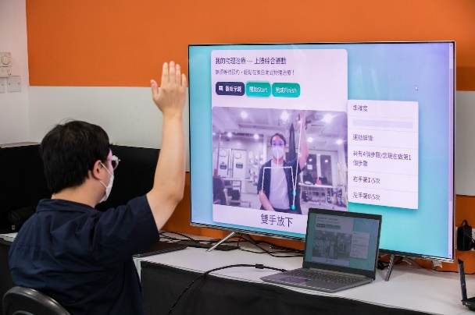
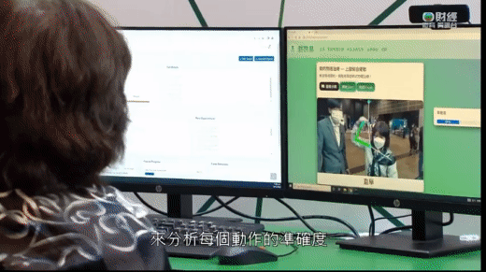
Self-Phy: Project Background
Hong Kong has a high demand of physical therapist
The ratio between registered physiotherapist and patient is about 1:3800
Of the 3800 patients, each physiotherapist treats an average of 662 elderly people
The average queening time of physical therapist service in public hospital is about 33 weeks
Demonstration of Self-Phy

Slide 4
Research Gap
With the competition on the development of new technologies are increasing tremendously in recent decades, which forces all industrial sectors are more likely to recruit high skilled and qualified graduates as they can bring more value to the company and help the company to survival in today’s highly competitive environment (Ramakrishnan & Yasin, 2011).
The concepts of institute and industry collaboration was first introduced by Sunderland Technical College in Northern England in 1903, which was known as the “Sandwich Program” (Zhao & Wang, 2008). The collaboration between Institute and industry has existed for more than ten decades, especially in the area of technology.
However, there is still a missing research gap focusing on developing healthcare system by the collaboration between institute and industry in the context of Hong Kong especially with the participation of NGO&NPO (Samuel & Omar, 2015).
Thus, the objective of this study is to investigate and fill the research gap of the collaboration framework between three parties for the coronavirus period and post corona virus era for the artificial intelligence-based healthcare system.

Slide 5
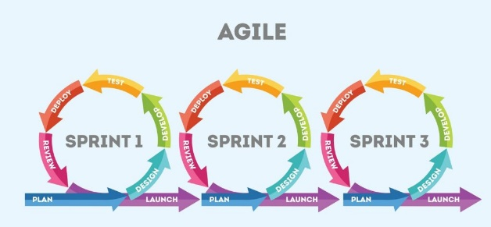
Collaboration Framework (1)
Project Duration | 12 months - SEP 2021 to AUG 2022
Project area | Artificial Intelligence based Healthcare System
Project Team | 4 Software Engineering students from VTC 1 industrial partner 1 NGO&NPO partner
Software Development Model | Agile Model
Number of iterations | 11
Duration of each iteration | 4 weeks
Table 1: Summary of the project details and collaboration framework

Slide 6
Collaboration Framework (2)
Date | Iteration Number | Iteration Content
SEP 2021 | 1 | A. Technical meeting with industrial partner & prototype implementation (last for 3 to 3.5 weeks) B. Project prototype showcase to industrial partner, NGO&NPO, and potential user
OCT 2021 | 2
NOV 2021 | 3
DEC 2021 | 4
JAN 2022 | 5
FEB 2022 | 6
MAR 2022 | 7
APR 2022 | 8
MAY 2022 | 9
JUN 2022 | 10
JUL 2022 | 11
Table 2: Summary of agile iteration

Slide 7
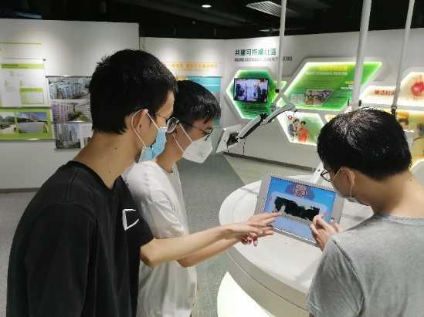
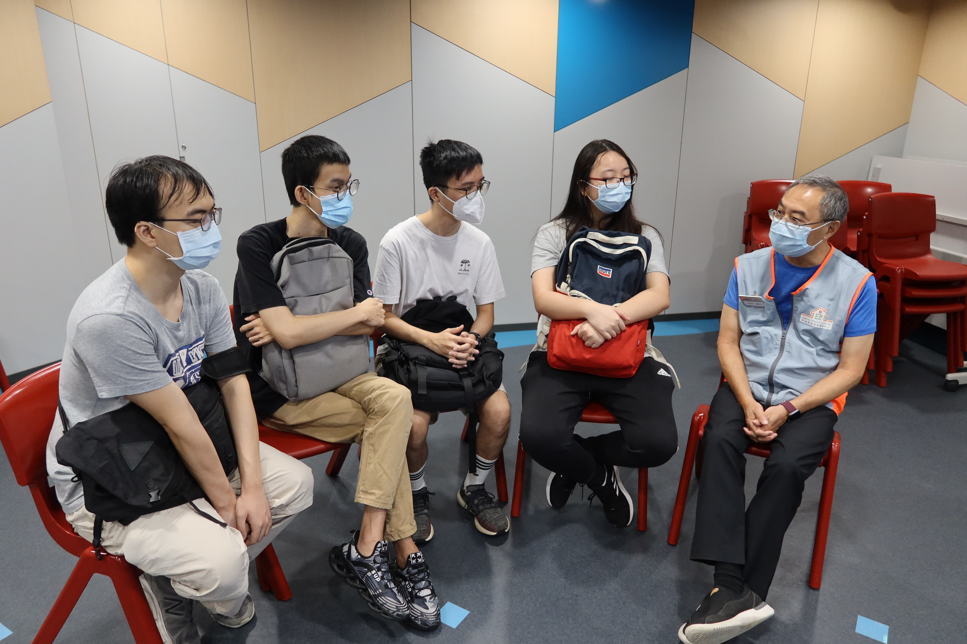
Collaboration Framework (3)
Learning Activities organized by NGO&NPO
Visiting Elderly Resources Center of Hong Kong Housing Society
Meeting with potential user in person

Slide 8
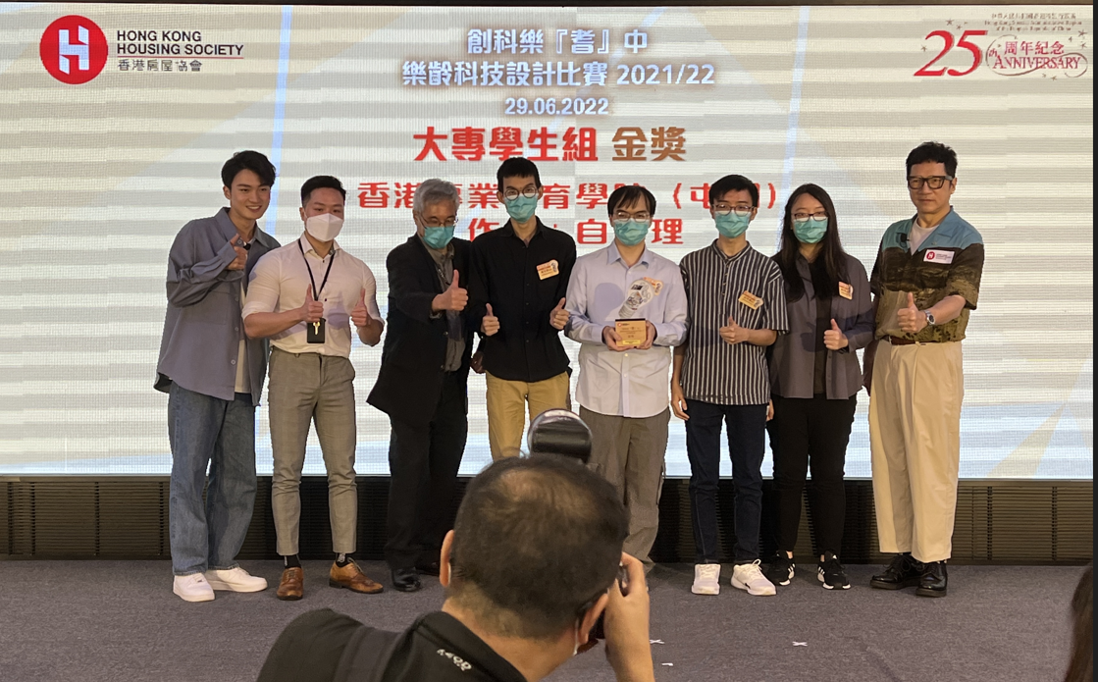
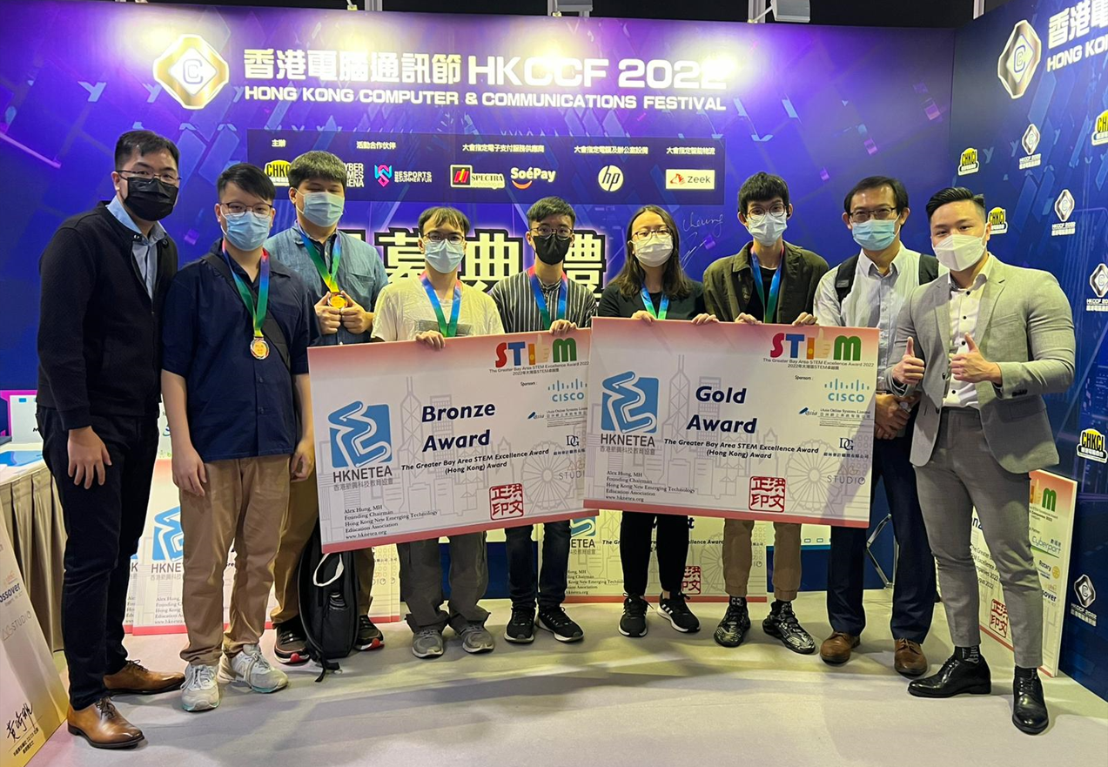
Collaboration Result (1)
The project was received several awards in public competitions in Hong Kong. The details are as follows:
Hong Kong Housing Society (HKHS) Gerontech Competition 2021/22: Gold Award, Best Creativity Award, Best Application Award
The Greater Bay Area STEM Excellence Award 2022 (Hong Kong) - A.I. Stream: Gold Award
Award ceremony of Hong Kong Housing Society (HKHS) Gerontech Competition 2021/22
Award ceremony of the Greater Bay Area STEM Excellence Award 2022 (Hong Kong)

Slide 9
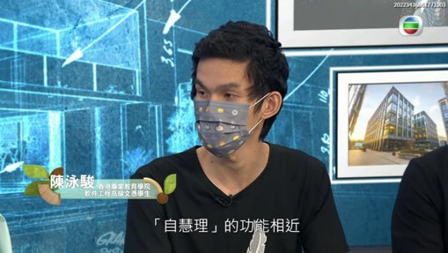
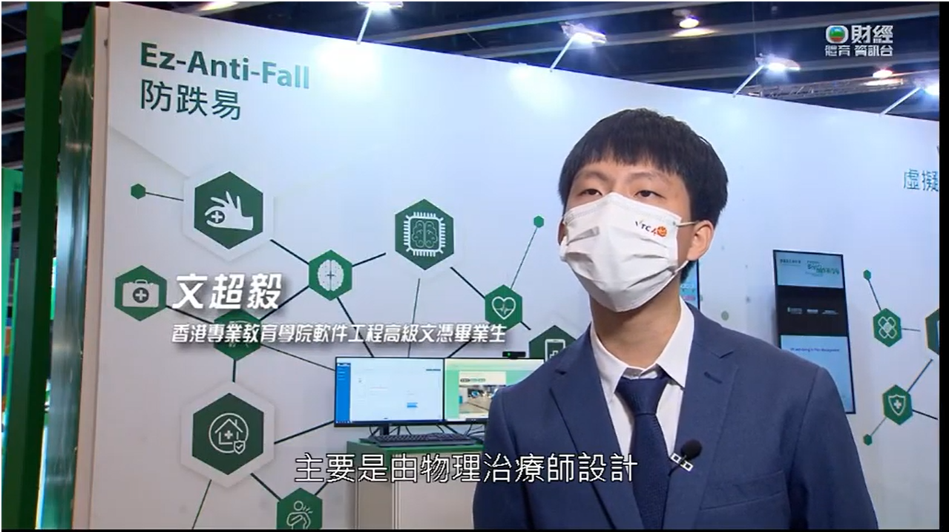
Collaboration Result (2)
Media sharing + Startup support
Screenshot of “Happy Old Buddies” on 29 September 2022
Screenshot of “Innovation GPS” on 5 January 2023

Slide 10
Discussion
At the end of the project, an interview section with students, industrial partner and NGO&NPO was conducted in order to collect feedback and best practice of this collaboration.
From the perspective of industry and NGO&NPO, they are more preferred to provide support to students through the online meeting as they have time constraints because of their busy work schedule.
From the perspective of students, even though the adoption of online meeting can save the traveling time, they reported that their sense of belongings of the project will be increased if they can report to the industrial partner and NGO&NPO in person at least once per month.
In the post coronavirus era, it is suggested that:
We can adopt bi-iteration approach to conduct the project collaboration
Students could stay at industrial partner’ workplace one to two times per week to implement the project according to the school schedule and industrial partner’s schedule in order to let students experience life in the workplace which is beneficial for students to better prepare themselves to be an outstanding employee after graduation.

Slide 11
Limitation and future directions
The research framework only tested in the area of Artificial Intelligence-based intelligence products, services, and systems, while other subject area may not be able to adopt the framework directly.
Further research directions can be based on the framework proposed in this study, researchers can further explore and develop framework to adapt to the fast-growing ICT environment and conduct additional research to adapt the framework of this study according to the subject area, and to compare and evaluate the performance between newly developed framework and other collaborative framework.

Slide 12
Reference
Mirko P., Lenardo C. e S., Alexandre C., Felipe R., Renata S., Arthur F., Ednaldo D., Emanuel D.,
Danilo S., Kyller G., Kyller A., and Angelo P. (2020). Intelligent Software Engineering in the Context of Agile Software Development: A Systematic Literature Review. Information and Software Technology, 119, 106241.
Ramakrishnan, K. & Yasin, N. M. (2011). Higher learning institution - Industry collaboration: A necessity to improve teaching and learning process. 6th International Conference on Computer Science & Education (ICCSE), 1445-1449.
Samuel, A. & Omar, A.T. (2015). Universities-industry collaboration: A systematic review. Scandinavian Journal of Management, 31(3), 387-408.
Sapna, C. (2022). What is Agile?. LinkedIn Learning. Retrieved from https://www.linkedin.com/pulse/what-agile-sapna-choudhary?trk=articles_directory
Tore, D. & Torgeir, D. (2008). Empirical studies of agile software development: A systematic review. Information and Software Technology, 50(9-10), 833-859.
Zhao, W. & Wang, A. (2008). University-industry Collaboration for Software Engineering Teaching. Proceeding of the 9th International Conference for Young Computer Scientists, IEEE Computer Society, 2681-2685.

