Slide 1
A Case Study of Sightseeing Tour Boat Accident Off the Shiretoko Peninsula
and Pedagogic Importance of Case Studies in Engineering Ethics Education
SHIMURA Yukinori
Faculty of Liberal Arts
National Institute of Technology, Wakayama College

Slide 2
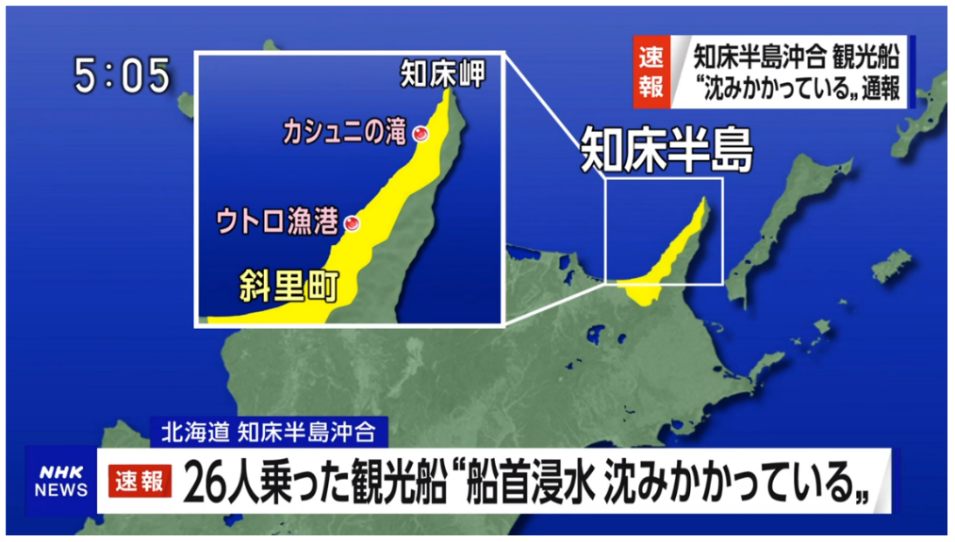
01/20
1. Outline of the accident
2. Analysis
3. Discussion
4. Teaching Scheme
5. About the case study
NHK reported the accident 3 hours after the sinking.

Slide 3
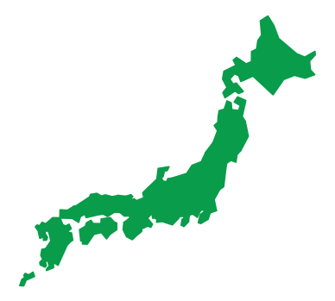
02/20
Shiretoko
The Japanese archipelago

Slide 4
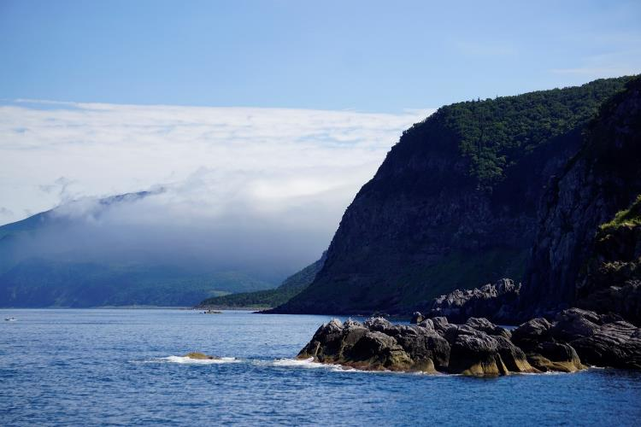
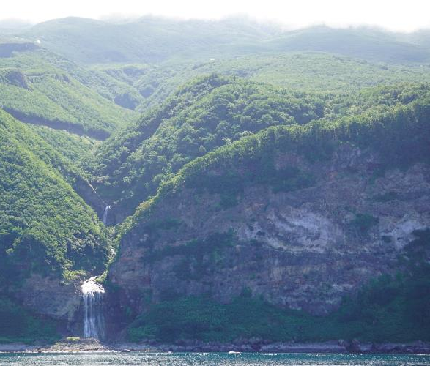
03/20
Shiretoko Peninsula is a popular tourism spot with rich nature.
Photo: Shimura Yukinori（ August 30, 2023 ）

Slide 5
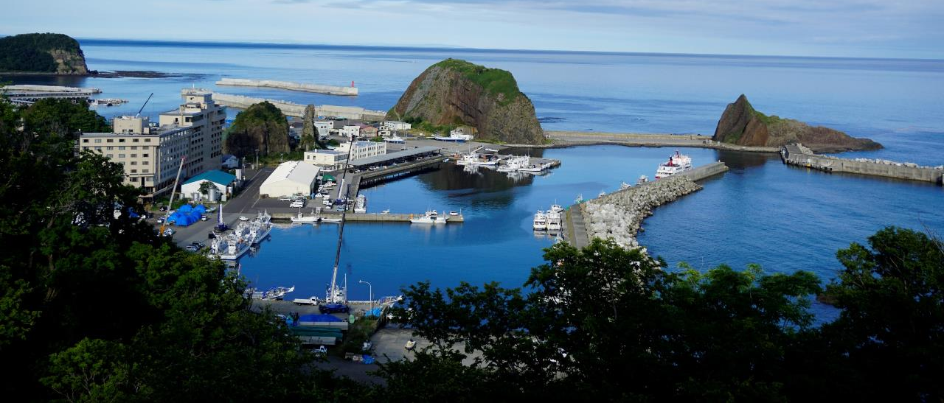
04/20
Utoro Port in Shari Town
Photo: Shimura Yukinori（ August 30, 2023 ）

Slide 6
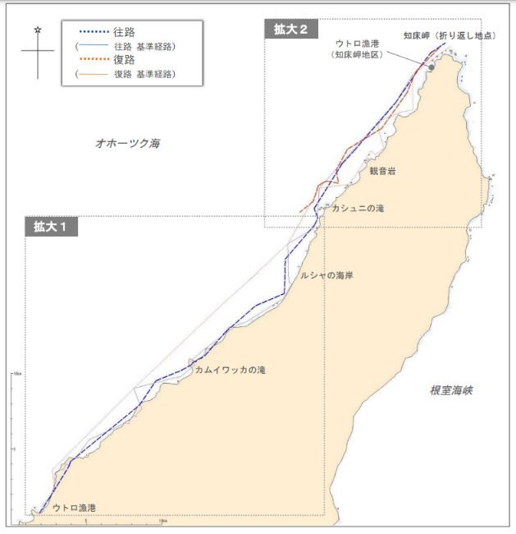
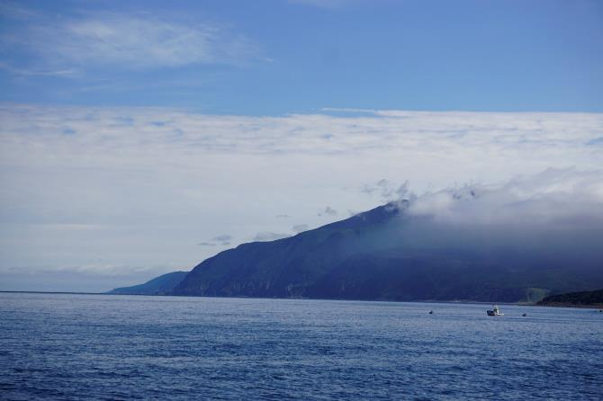
05/20
Cape Shiretoko
The spot where KAZU Ⅰ was found.
×
Kashuni-no-Taki Falls
×
Photo: Shimura Yukinori（August 30, 2023）
Route map
JSTB (2022), Progress Report, p. 15.
Utoro Port

Slide 7
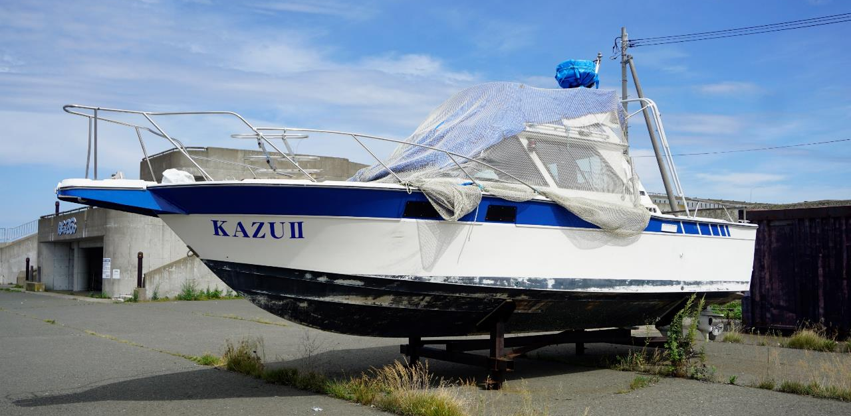
06/20
Six factors of the accident
Hull structure
2) Judgment on the departure
3) Compliance with the codes of safety and management
4) Effectiveness of inspection
5) Lifesaving equipment and telecommunication device
6) Framework of search and rescue

Slide 8
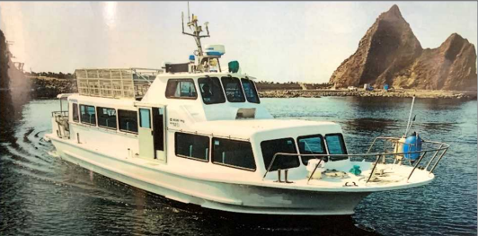
07/20
KAZU Ⅰ (19 tons, 570kW) before the accident.
Photo: JSTB (2022), Progress Report, p. 1.

Slide 9
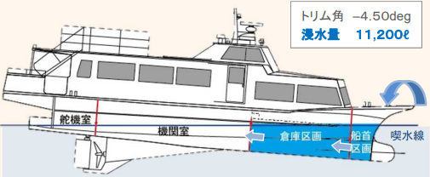
08/20
Water intruding from the hatch into compartment and engine room
JSTB (2022), Explanatory Material about the Accident of Flooded Leisure Boat KAZUⅠ, p. 21.

Slide 10
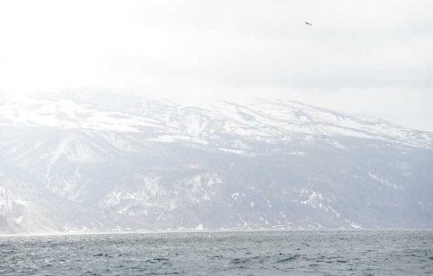
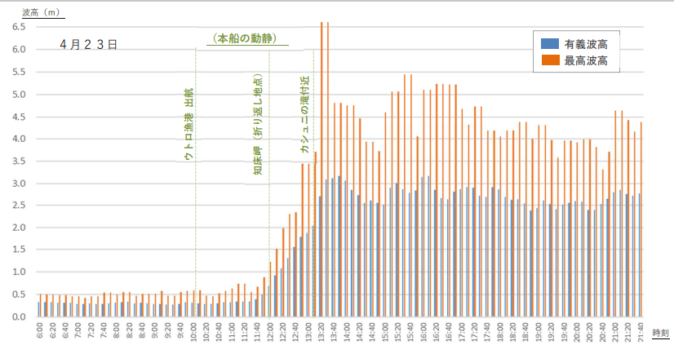
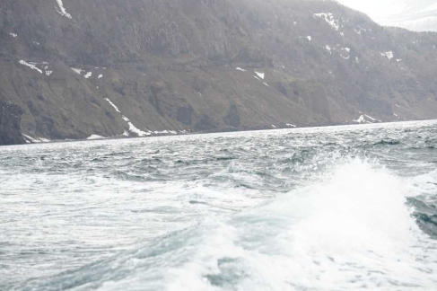
09/20
Wave height off Shiretoko Peninsula on April 23, 2022
Graph: JSTB (2022), Progress Report, p. 25.
Off Shiretoko Peninsula at 11:22 AM
Photos: JSTB (2022), Progress Report, p. 23.

Slide 11
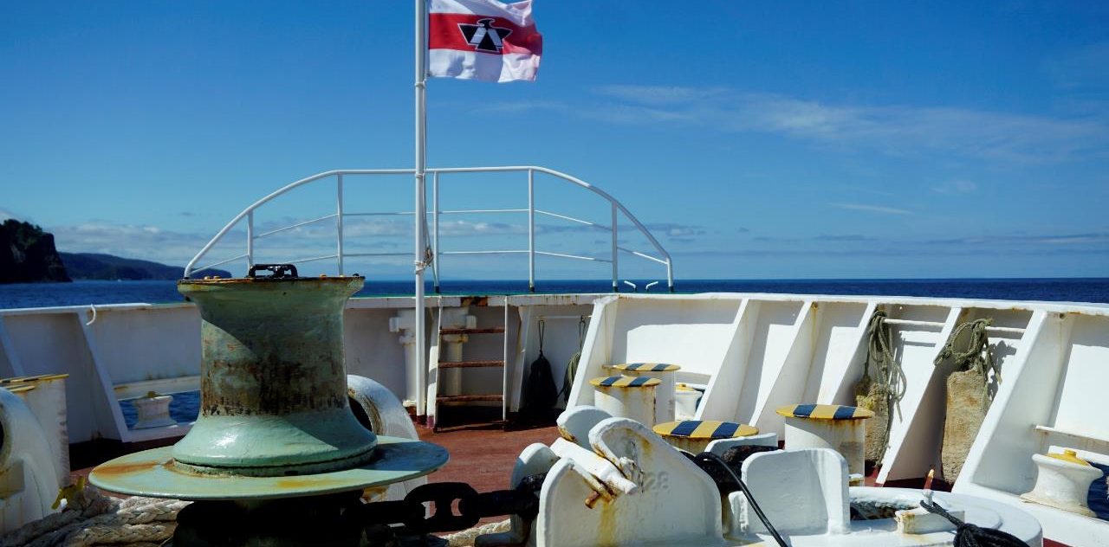
10/20
Key words in engineering ethics
1) Bounded rationality and trade-off
2) Cost-benefit analysis
3) Compliance

Slide 12
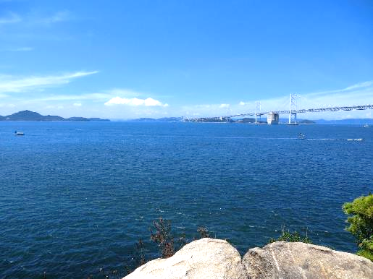
11/20
Okhotsk Sea
Seto Inland Sea
Seto Inland Sea
Photo: Shimura Yukinori ( July 7, 2011 )

Slide 13
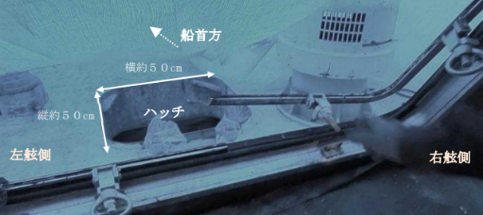
12/20
Pilothouse
Hatch
Sight form the pilothouse
Image: JSTB (2022), Progress Report, p. 31.
The hatch after the accident
Photo: JSTB (2022), Progress Report, p. 32.
Hatch

Slide 14
13/20
Openings through the bulkhead partitioning warehouse area and engine room
Image and photos: JSTB (2022), Progress Report, p. 34.

Slide 15
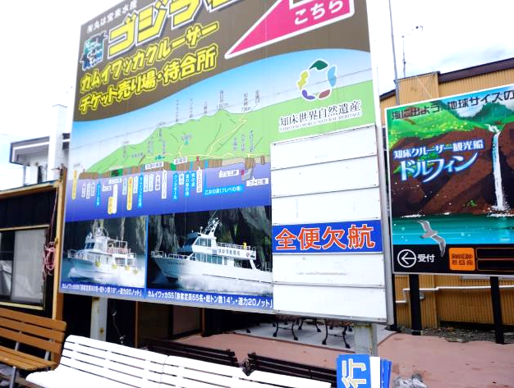
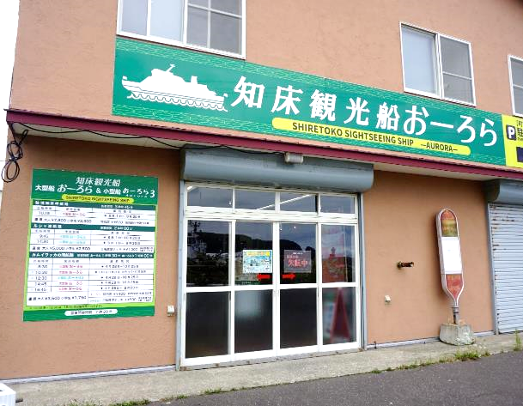
14/20
Several companies operate sightseeing tour boats in Utoro area.
Photo: Shimura Yukinori（ August 30, 2023 ）
La Sorbonne
ソルボンヌ

Slide 16
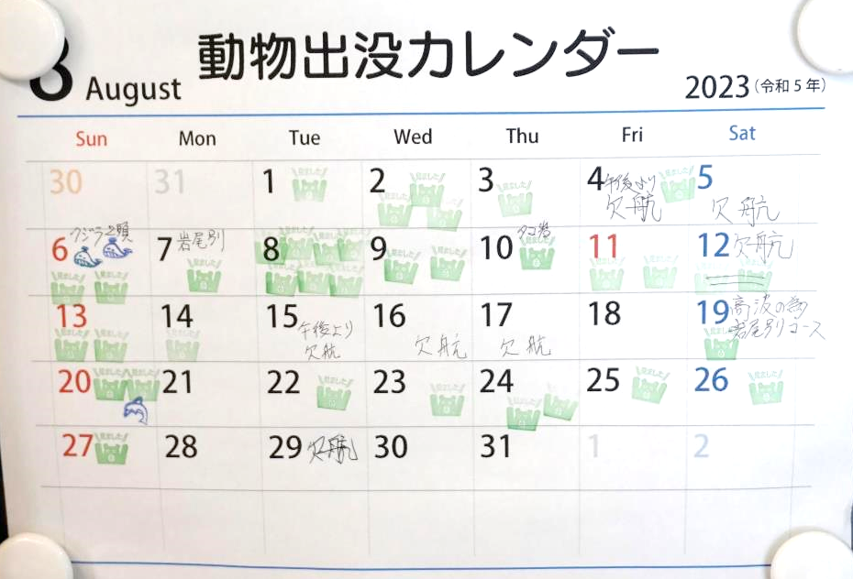
15/20
Canceled
Canceled
Canceled
Canceled
Canceled
Canceled
Operations are often canceled
due to the weather.
Photos: Shimura Yukinori（ August 29 and 30, 2023 ）
Canceled

Slide 17
16/20
Teaching Scheme
1) Introduction
https://www.youtube.com/watch?v=wl6M9lpMmZw
JSTB (2022), Explanatory Material about the Accident of Flooded Leisure Boat KAZUⅠ

Slide 18
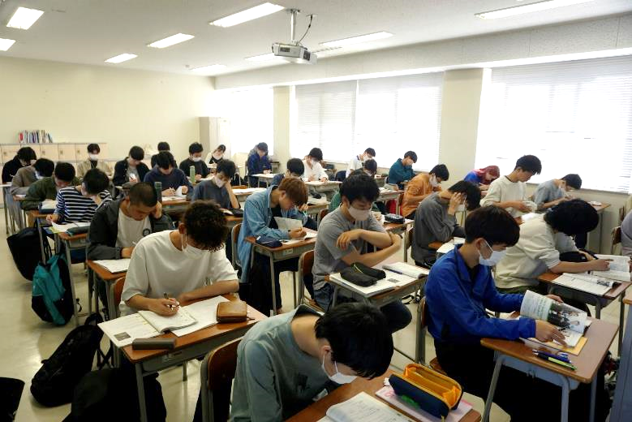
17/20
Teaching Scheme
2) Analysis
▷Individual thinking
▷Think-pair-share
▷Group talk
A classroom in Wakayama KOSEN
Photos: Shimura Yukinori（ May 15, 2023 ）

Slide 19
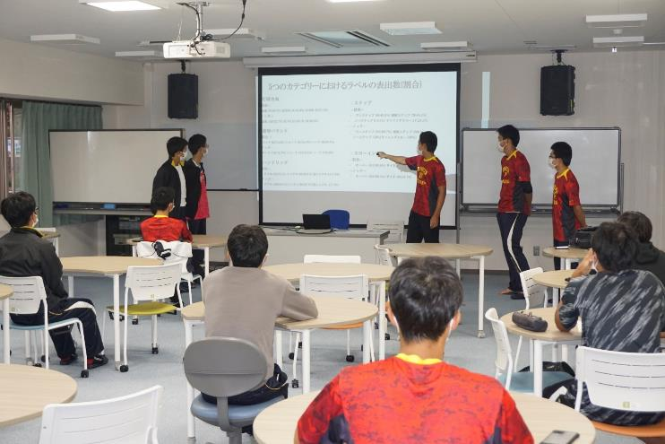
18/20
Teaching Scheme
3) Discussion
▷Debate
▷Presentation
▷Communication paper
A presentation session in Wakayama KOSEN
Photos: Shimura Yukinori（ October 27, 2021 ）

Slide 20
19/20
Classical cases
-ample
-accessible
-helpful
Latest cases
-stimulate students
-immune to the fixed viewpoint
-enable students to acquire information timely

Slide 21
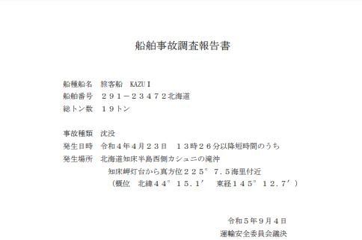
20/20
JTSB issued the final report of the accident on September 4, 2023.

Slide 22
Thank you for listening.
SHIMURA Yukinori
shimura@wakayama-nct.ac.jp

